Slide 1
MS Word Application
PADMA
ER/CORP/

Slide 2
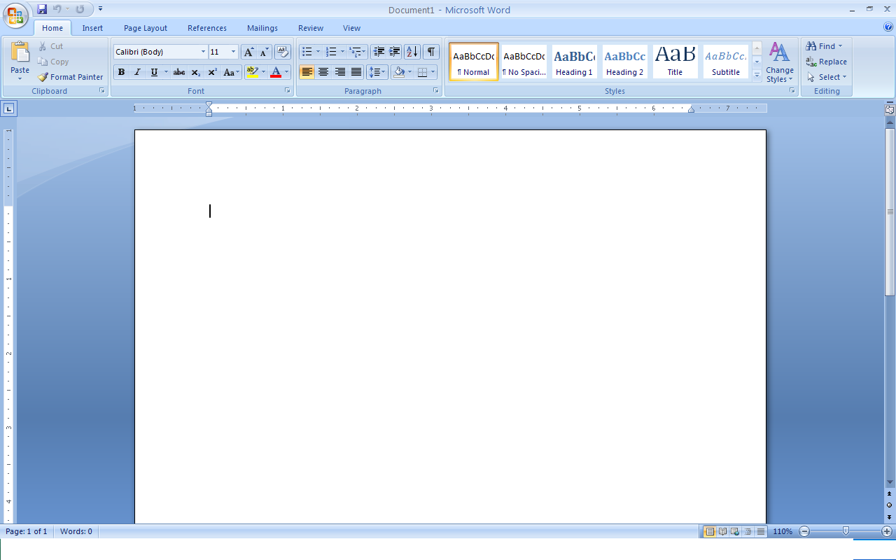
MS Word Primer
MS Word is a powerful general purpose, word processing program that can be used to create basic documents of all kinds of letters, memos, reports, charts, resumes etc
  Basic File Options
  Title Bar, Scroll Bar, Status Bar, Ribbons
Document View and Text Area
Formatting Options
Title bar
The Ribbon
Scroll Bar
Text Area
Status bar
Notes:
MS Word Primer:
Basic File Options like Open, Copy, Cut, Paste, Save & Exit
Formatting Options like Font Style, size, Bullets & Numbering, Borders and Shading, Paragraphs, Page setup & printing options

Slide 3

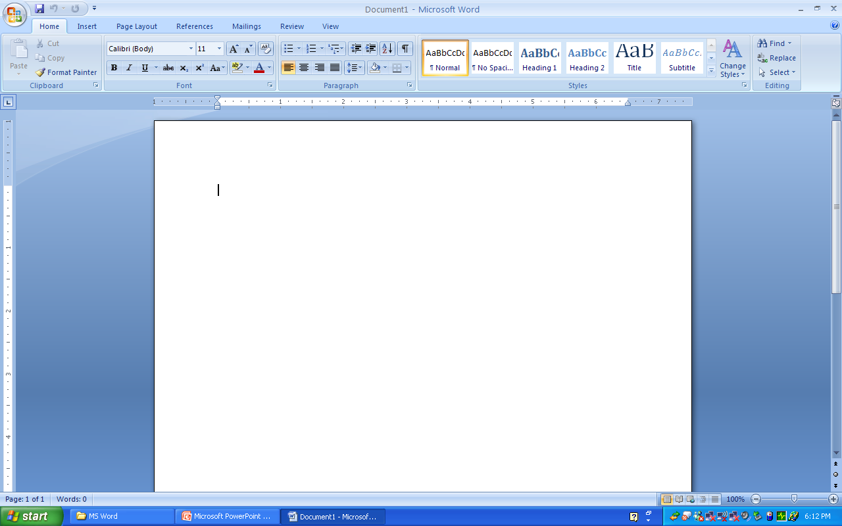
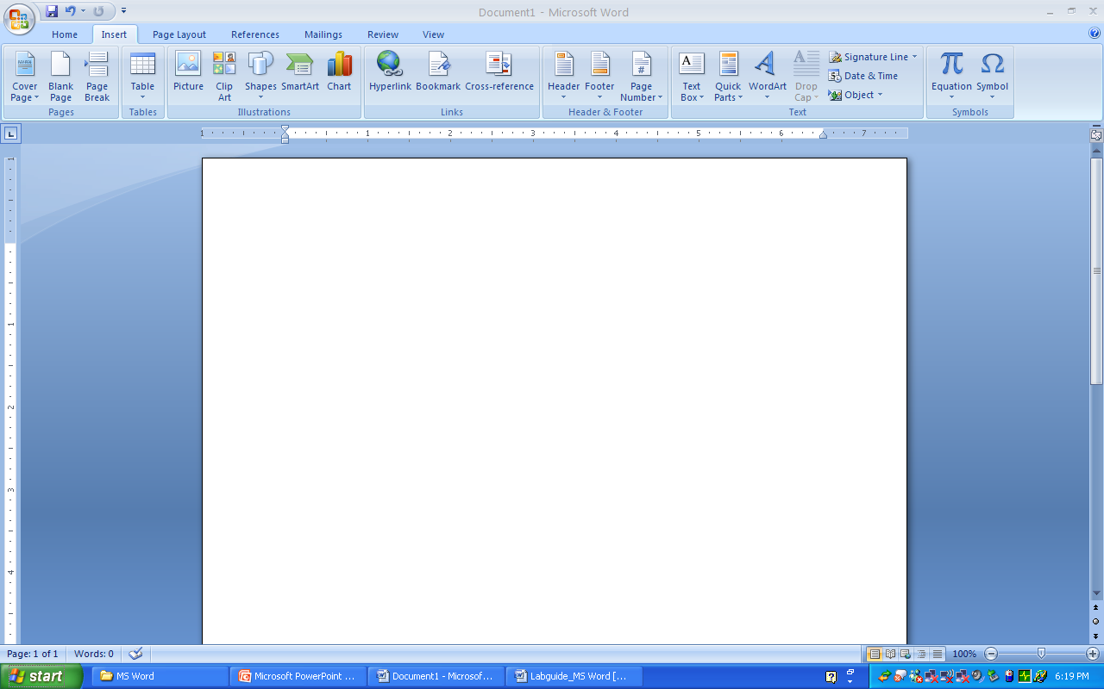
Edit options in Word Document (1/2)
Undo & Redo Options
Find & Replace
Bookmark and Go to Options
Notes:
Undo & Redo Options
Most recent actions can be undone and redone.
Find & Replace
Finding the exact match / format
Replacing the text
Bookmark and Go to Options
Identifies a location / selection of text that you name and identify for future reference.
For example, you might use a bookmark to identify text that you want to revise at a later time. Instead of scrolling through the document to locate the text, you can insert a Bookmark.
Format Painter
Used to apply the formatting to more than one block of a text
Inserting Pictures & Objects
From the clip art gallery
Creating from the files

Slide 4
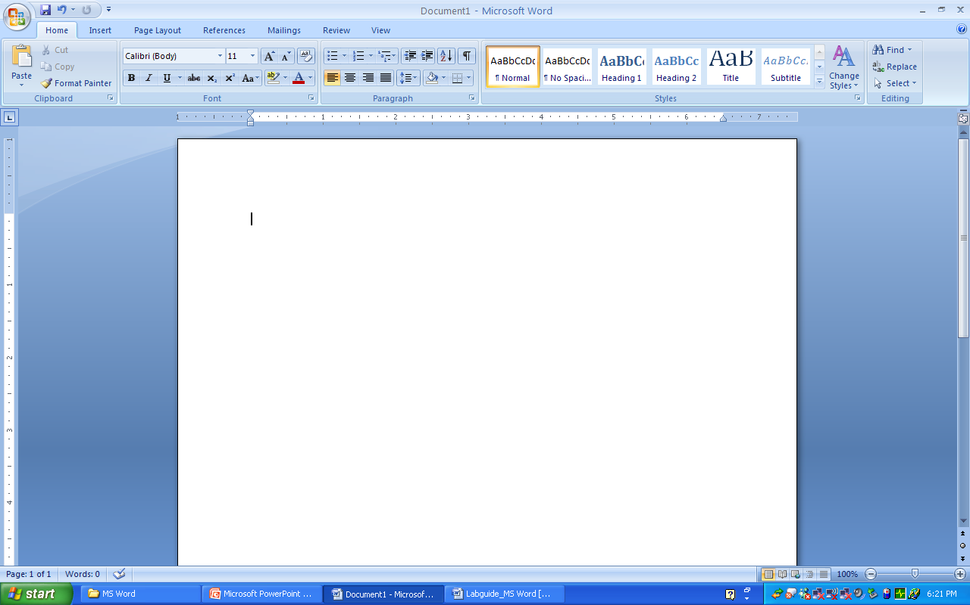
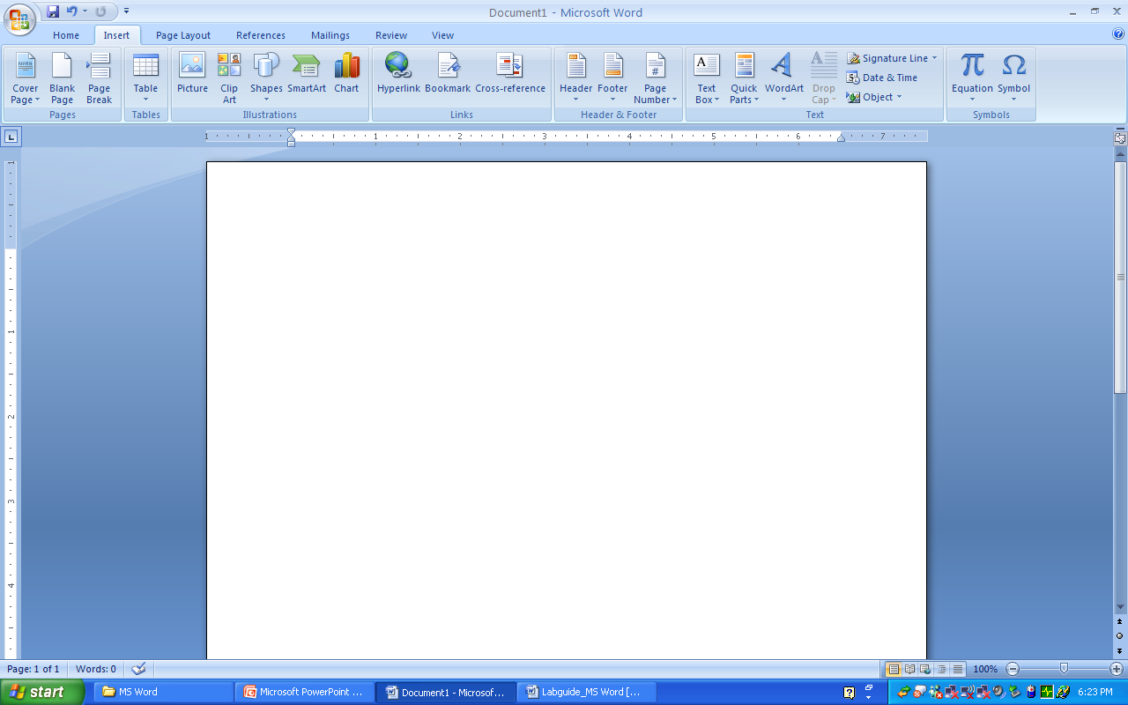
Edit options in Word Document (2/2)
Format & Format Painter
Inserting Pictures & Objects

Slide 5
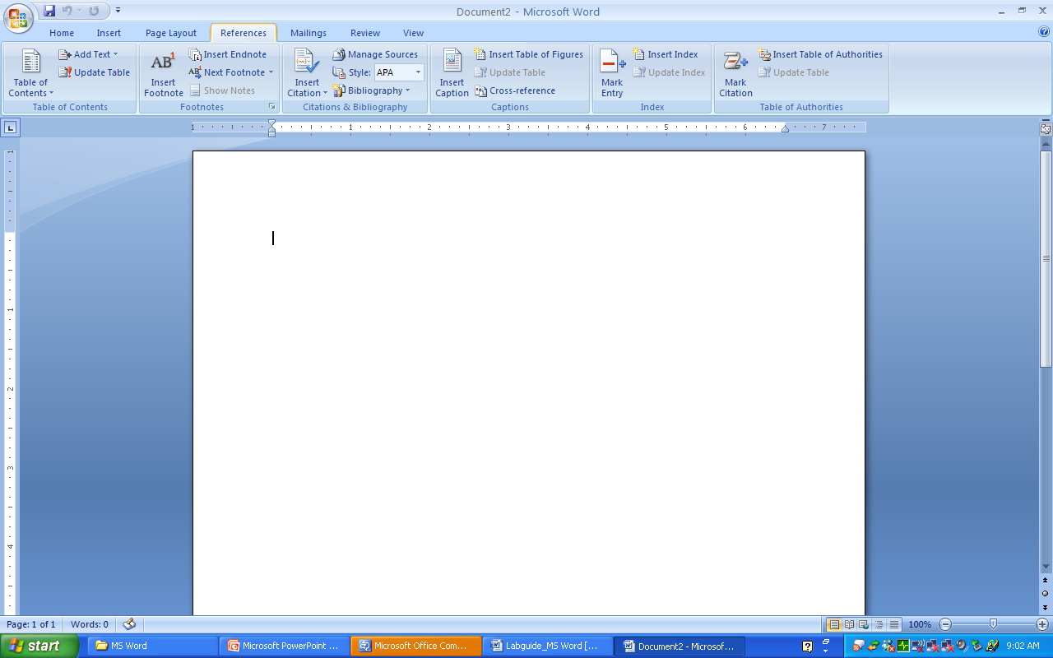
References (1/2)
Inserting Footnotes & End Notes
Hyperlinks
Notes:
Inserting Footnotes & End Notes
Used in printed documents to explain, comment on or providing references for text in a document.
Use footnotes for detailed comments
Use endnotes for citation of sources
Hyperlinks
Created for locating the files or a piece of information easily
Table of Contents (TOC)
Gives readers a brief outline of the topics discussed in a document and helps them to find their way around it.

Slide 6
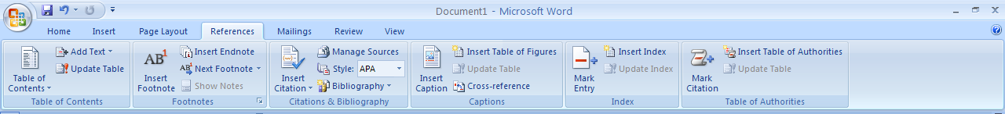
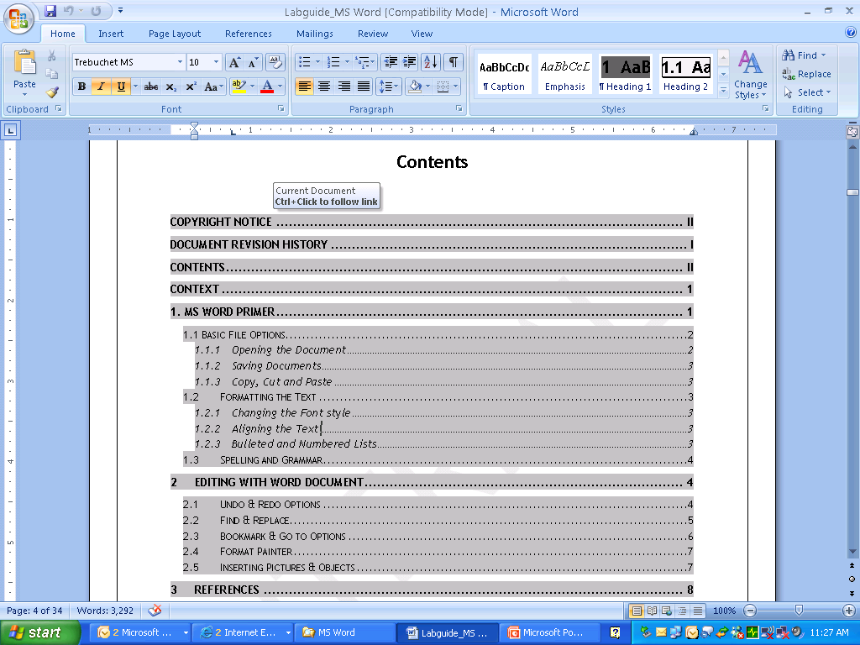
References (2/2)
Table of Contents (TOC)

Slide 7

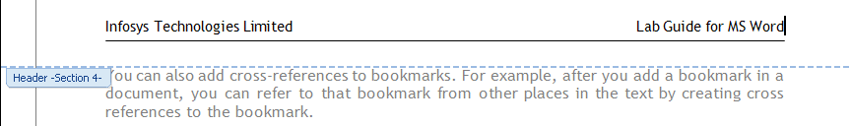
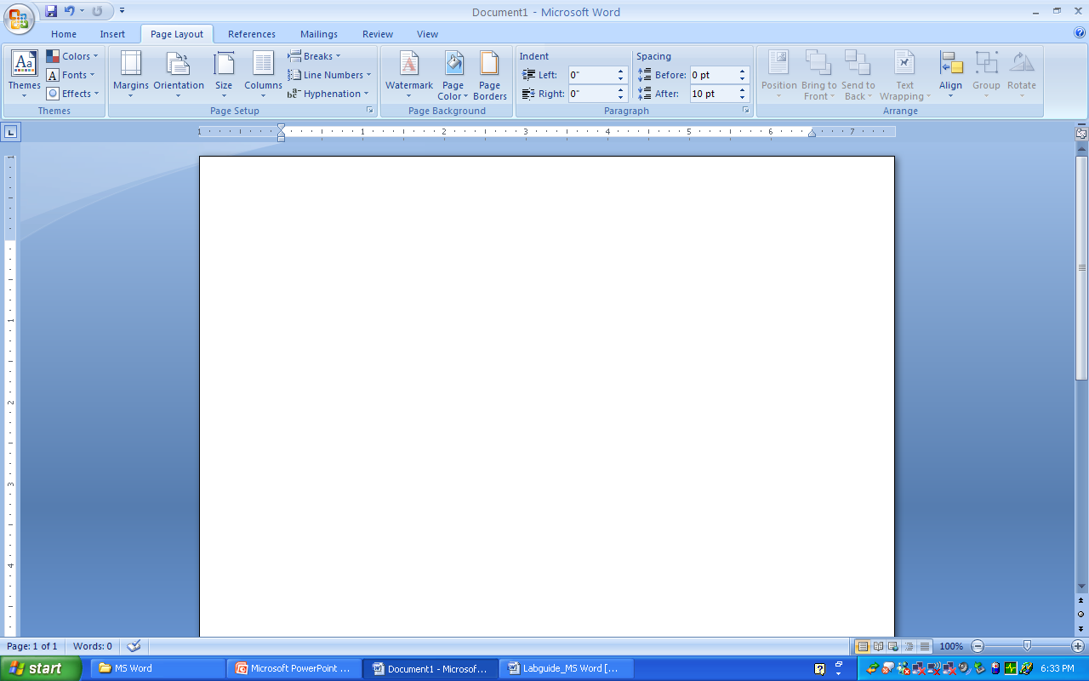
Page Layout
Page, Line & Column Breaks
Header & Footer
Watermarks
Notes:
Page, Line & Column Breaks
Line, Page / page breaks ends the current line, page / column and continue the text in the next line, page/ column.
Header & Footer
Header is a block of a text / graphics displays at the top of every page of the document
Footer is a block of a text / graphics displays at the bottom of every page of the document
Header & Footer appears in the print layout
Watermarks
Watermarks are text or pictures that appear behind document text.
They often add interest or identify the document status, such as marking a document as a Draft.
You can see watermarks in Print Layout view and Full Screen Reading view or in a printed document.

Slide 8
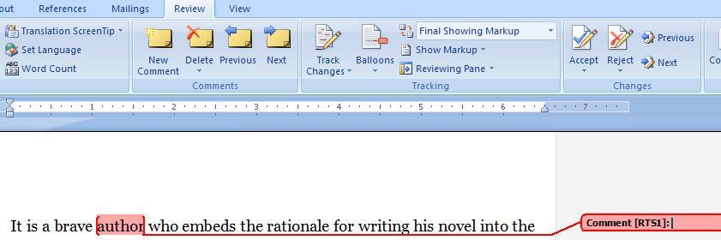
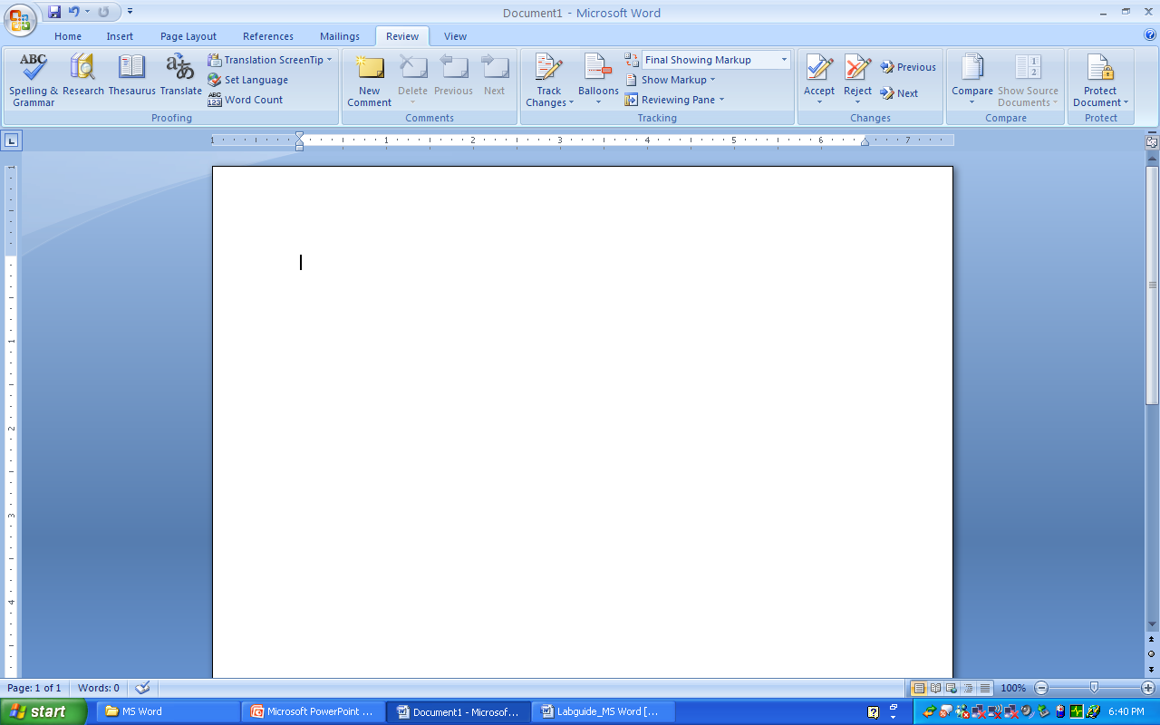
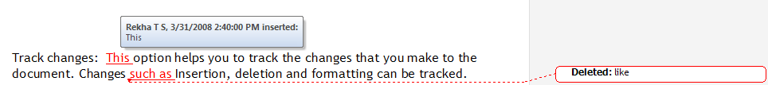
Reviewing Features (1/2)
New Comments
Track Changes (Accept / Reject)
Notes:
New Comments
Text Comment
Voice Comment
Track Changes (Accept / Reject)
Track changes are used to identify the changes updated / modified to the document.
The changes thus made can either be accepted or rejected
Protecting the document
A document can be protected against any unwanted changes to be made. Restricted access can also be given to the reviewers

Slide 9
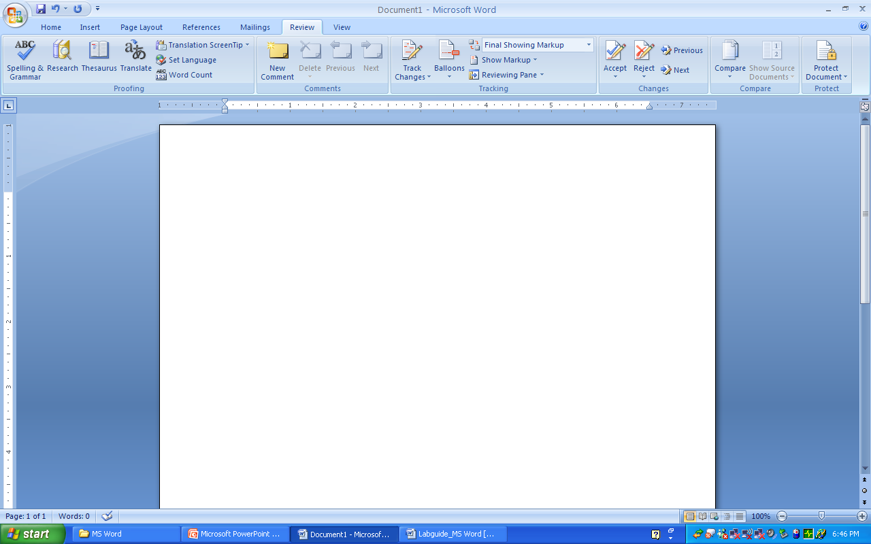
Reviewing Features (2/2)
Protecting the document

Slide 10
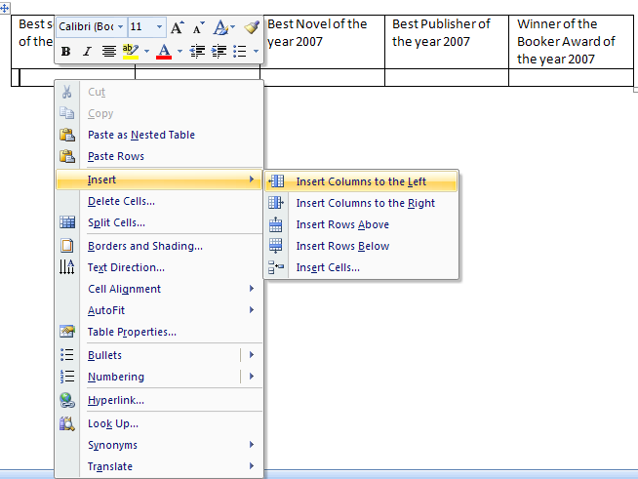
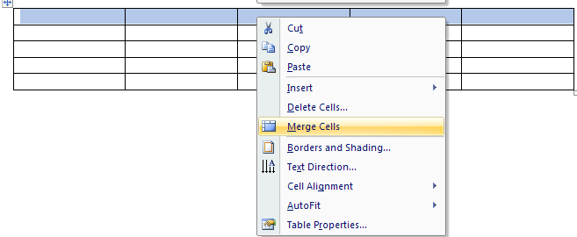
Tables & Charts
Creating a Table
Adding / Deleting rows & columns
Merge Cells
Best selling book of the year 2007 | Best Author of the year 2007 | Best Novel of the year 2007 | Best Publisher of the year 2007 | Winner of the Booker Award of the year 2007
Notes:
Creating a Table
MS Word Table is a highly versatile tool for arranging text in rows and columns.
Adding / Deleting rows & columns
Merge Cells
Using Formulae
Using MS Word, you can perform mathematical calculation

Slide 11
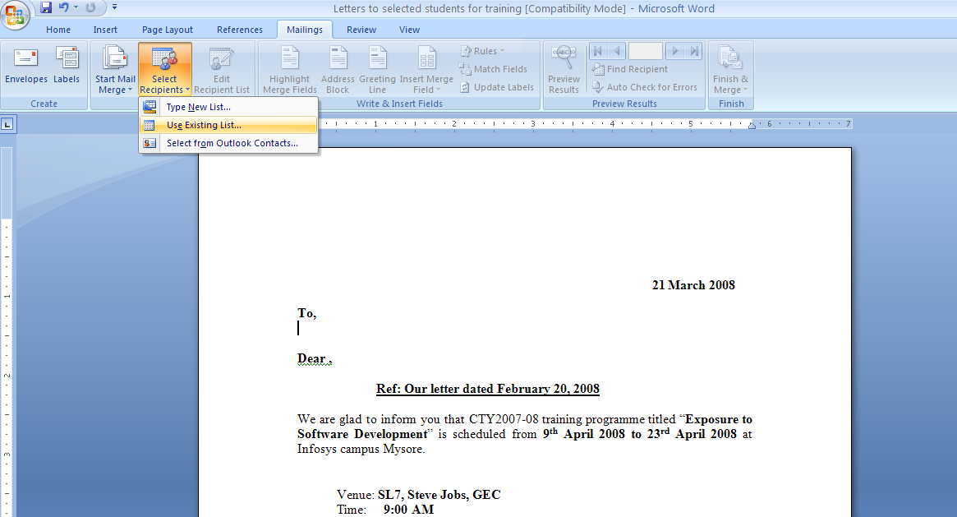
Mail Merge using references from MS Excel (1/6)
  Steps that shows merging the letter with the addresses,

Slide 12
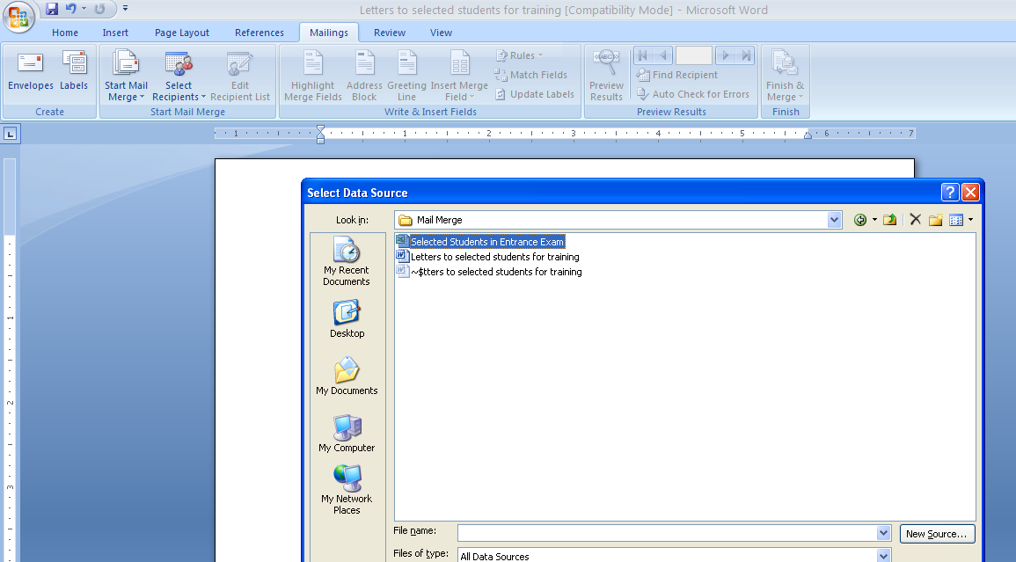
Mail Merge using references from MS Excel (2/6)

Slide 13
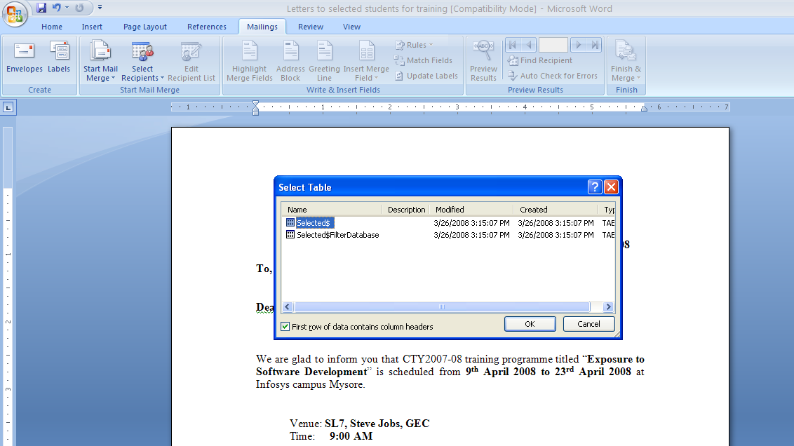
Mail Merge using references from MS Excel (3/6)

Slide 14
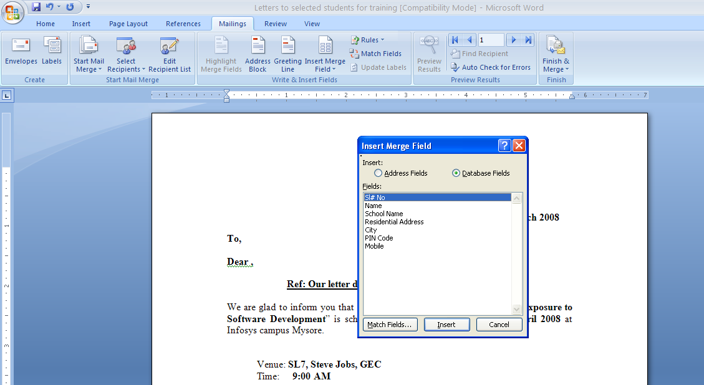
Mail Merge using references from MS Excel (4/6)

Slide 15
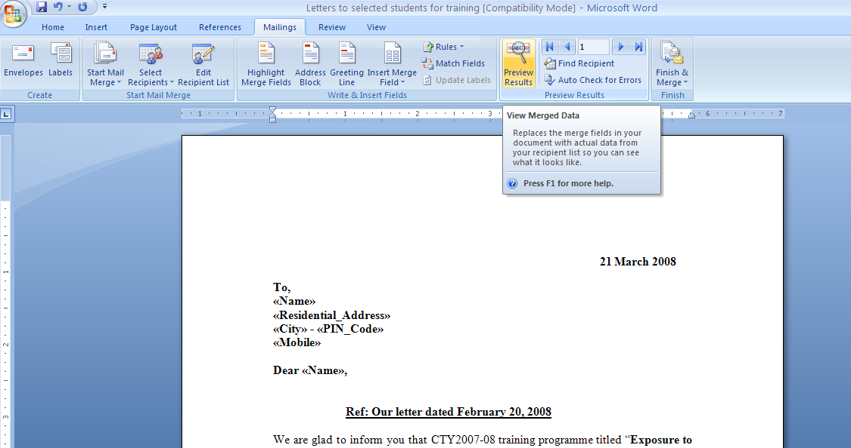
Mail Merge using references from MS Excel (5/6)

Slide 16
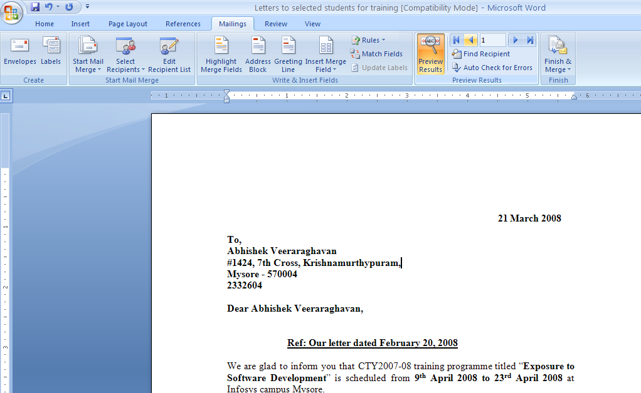
Mail Merge using references from MS Excel (6/6)

Slide 17
Envelopes & Labels
Creating the Labels

Slide 18
Printing the Word Document
Print option in Word allows you to print the document.

Slide 19

Thank You

